Slide 1
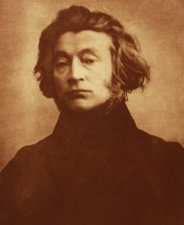
Adam Mickiewicz
Natalia Kożuch & Marcin Sosialuk

Slide 2
Biography
Adam Bernard Mickiewicz (24 December 1798 – 26 November 1855) was a Polish poet and dramatist. He is widely regarded as Poland's and European greatest poet.
Mickiewicz was born in the Russian. As a consequence like many of his compatriots, lived out the rest of his life abroad. He settled first in Rome, then in Paris, where for a little over three years he lectured on Slavic literature at the Collège de France. He died, probably of cholera.
In 1890, his remains were repatriated to Wawel Cathedral in Kraków, Poland.

Slide 3

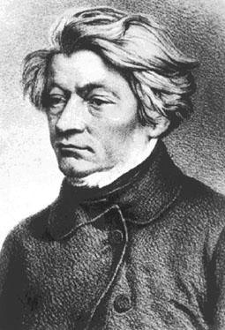
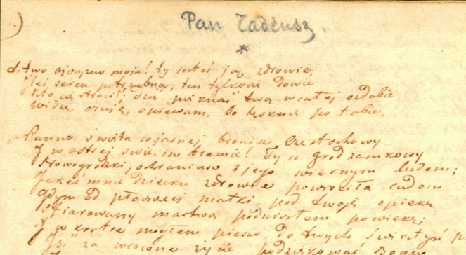

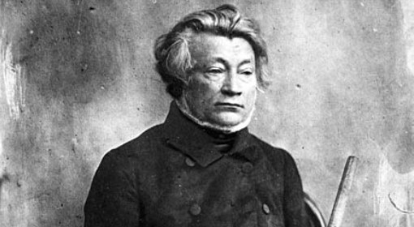
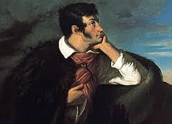

Slide 4
Achievments
He is known chiefly for the poetic drama Dziady (Forefathers' Eve) and the national epic poem Pan Tadeusz. His other influential works include Konrad Wallenrod and Grażyna. All these served as inspiration for uprisings against the three imperial powers that had partitioned the Polish-Lithuanian Commonwealth out of existence.

Slide 5
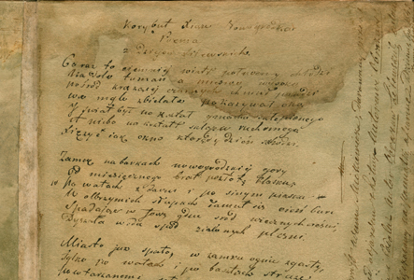
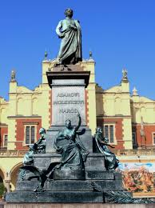


Slide 6
Curiosities
1. Mickiewicz has part in plays and played female characters because he has got petite silhouette (he has got only 164 cm growth ).
2. He was friends with Andrew Towiański founded and propagated by his movement, which today can be called a cult - "Wheel of Things of God.„
3. He moved 40 times because he liked a lot of women and he was fascinated in diffrent religious views.

Slide 7
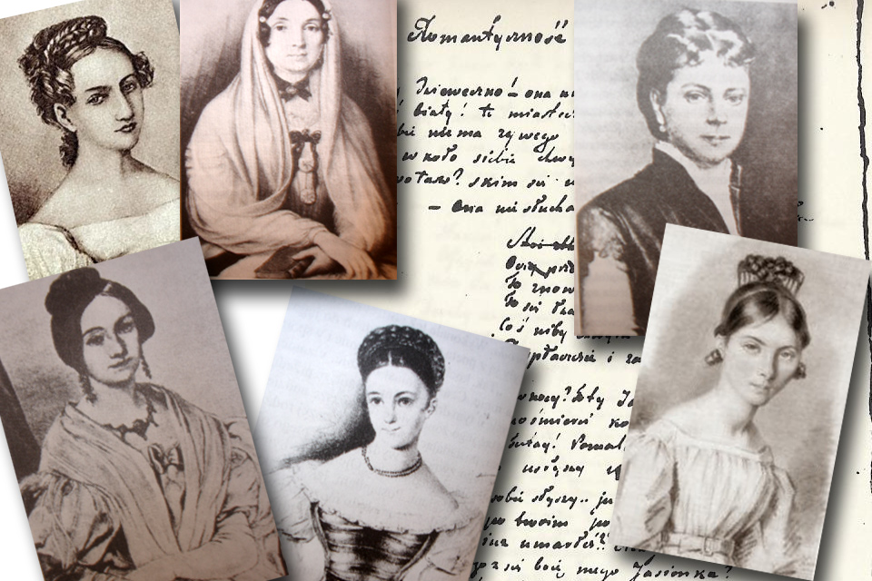
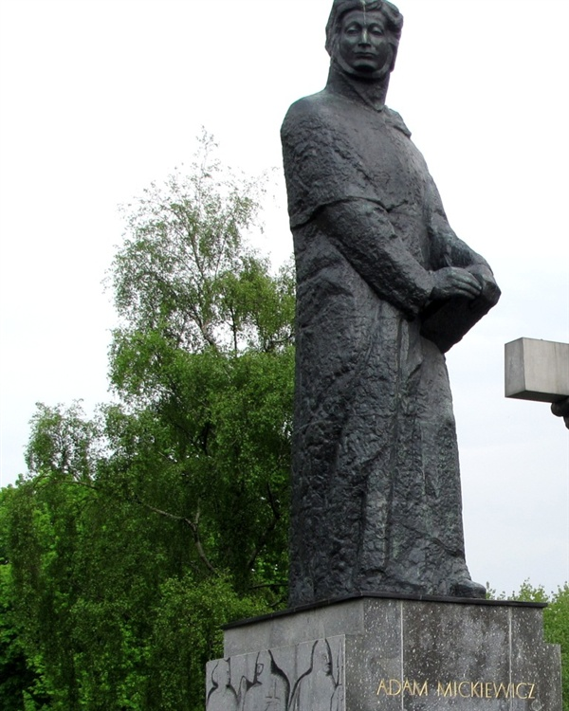


Slide 8
Dictionary
Commonwealth- wspoólnota
Consequenc- konsekwencja
Compatriots-rodacy
widely regarded- powszechnie uznawany
Chiefly- głównie
Influential- wpływowy
Curiosities- ciekawostki
petite silhouette- drobna sylwetka
Growth- wzrost
Sources- źródła

Slide 9
Sources
Wikipedia.org
Google grafika
Biografia24.pl

Slide 10
Thanks you for wathing !
Natalia & Marcin
Kl. 2A

