Slide 1
„Artysta z Przeszłości”

Slide 2
Leonardo da Vinci – renaissance Italian humanist. He was born the 15th April 1452 y. in Anchiano and died 2nd May 1519 in Clos Luce. He is called „The Renaissance Man” because of his curiocity and creativity. He is also called as the most talented man of the whole world.

Slide 3
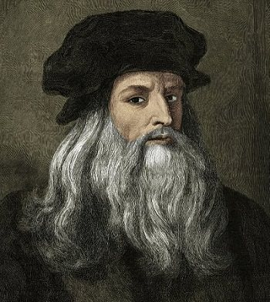

Slide 4
Projects and achievements
Leonardo da Vinci had a lot of achievements.
Because of that, we will show only the biggest.

Slide 5
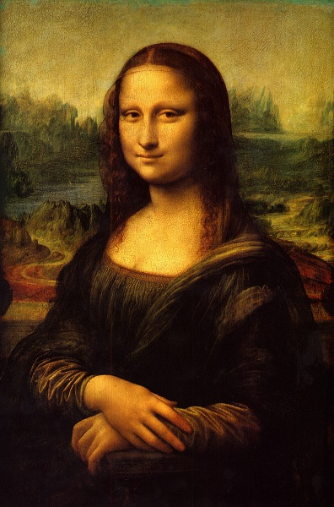
„Mona Lisa”

Slide 6
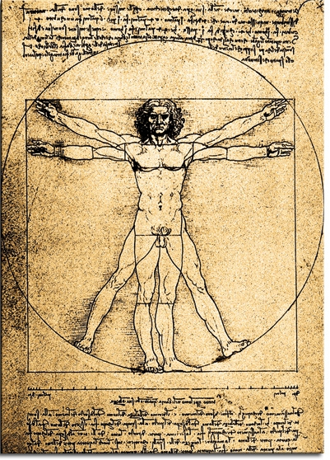
„Vitruvian Man”

Slide 7
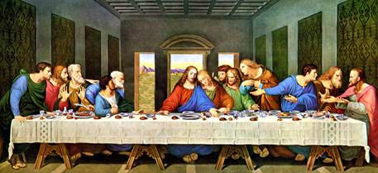
„Last Supper”

Slide 8
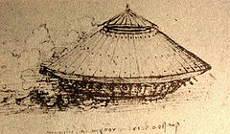
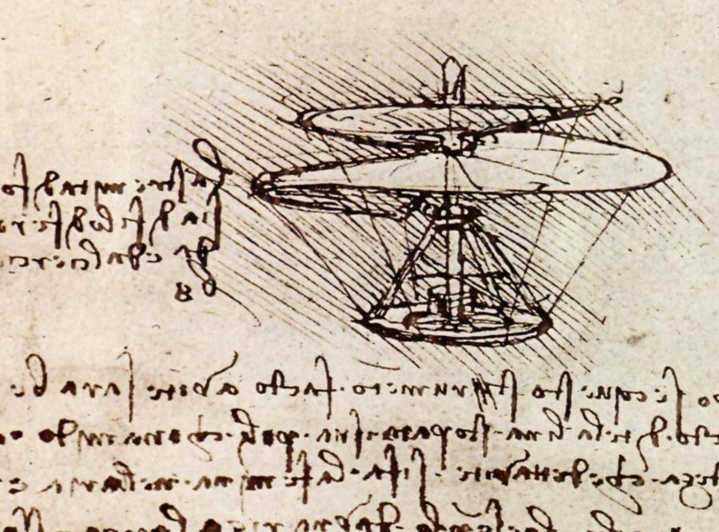
Tank and Helicopter Projects

Slide 9
Curiosities
-Leonardo da Vinci was doing autopsies on dead people that he dug from cementery. Because of that, he discovered how does the human body works and made the first Anatomy book. He was doing it in a mystery because he could be burned for that.

Slide 10
-Leonardo was always writing from right to left
It was called a „Mirror Image”
He was the first man in the world that explained why the sky is blue.
Leonardo was a vegetarian.
Leonardo was buying animals in cages to release them.

Slide 11
Słowniczek
Cage – Klatka
Curiocities – Ciekawostki
Mirror Image– Lustrzane Odbicie
Tank – Czołg
Renaissance – Renesans
Creativity – Kreatywność
Autopsies – Autopsje
Sky – Niebo
Achievements – Odciągnięcia
Release – Wypuścić

Slide 12
The Presentation was made by Klaudia Noga and Jakub Bachmatiuk from 2A Class.
Thank you for watchin’ ☺

