Slide 1
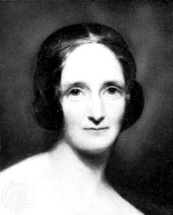

.Mary Shelley
How old was Mary Shelley when she wrote the novel Frankenstein?
Was Frankenstein a monster?
Who was Mary Shelley?
How was she connected
with Frankenstein?
Who was Mary Wollstonecraft Godwin?

Slide 2
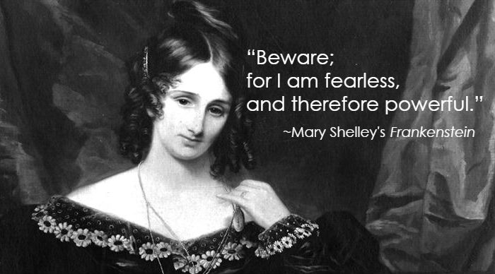
Mary Shelley
=
Mary Wollstonecraft
Godwin

Slide 3

Mary Shelley :
.Who was Mary Shelley?
Mary Shelley was born on August 30, 1797, in London [England]
An English poet and a writer romantic period
A former mistress of lord Byrona
Wife Percy Bysshe Shelly ( romantic poet)
She was daughter writer Mary Wollstonecraft
precursor of science fiction novels
She died in London (United Kingdom) for a brain tumor on February 01, 1851.

Slide 4
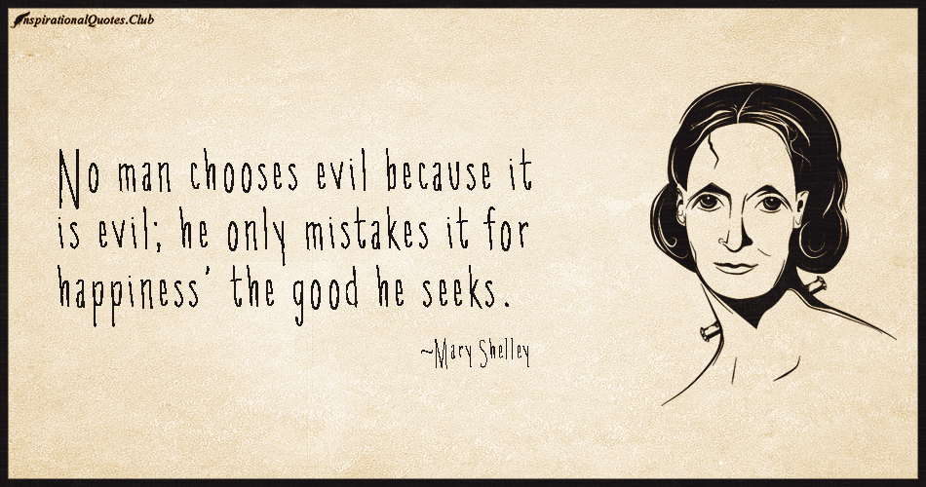

Slide 5
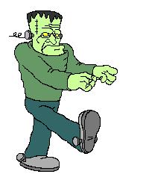
Who is
Frankenstein???...
?
?
?
?

Slide 6
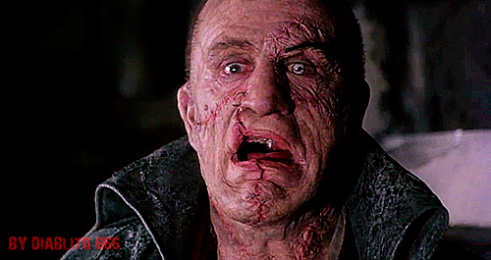
Facts
Frankenstein isn’t the name of the monster, this is the name of the doctor in the novel by Mary Shelley.
Dr. Victor Frankenstein creates an unnamed “monster”.

Slide 7
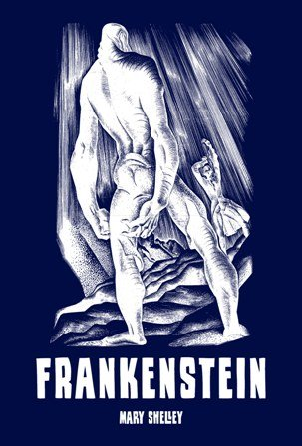
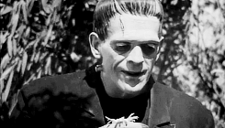
Frankenstein; or, The Modern Prometheus
The greatest work of Mary Shelly’s is Frankenstein; it was written when she was only 19 years!
This book has gained big popularity and it has been repeatedly filmed.

Slide 8
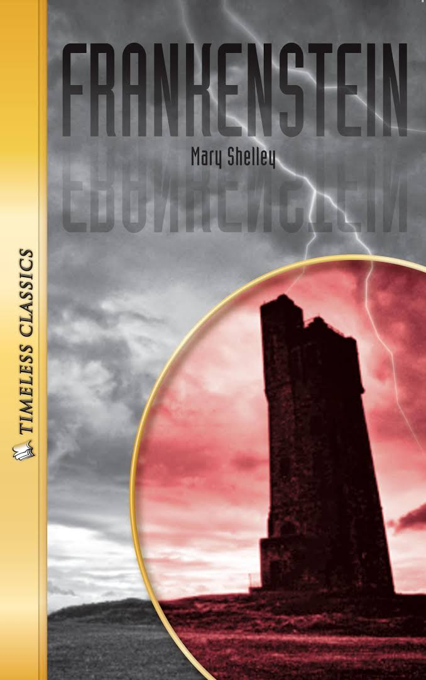
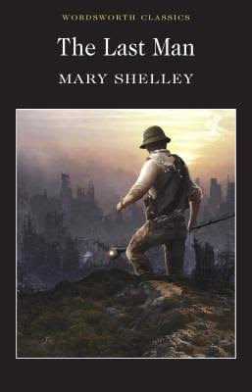

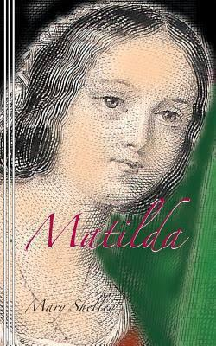
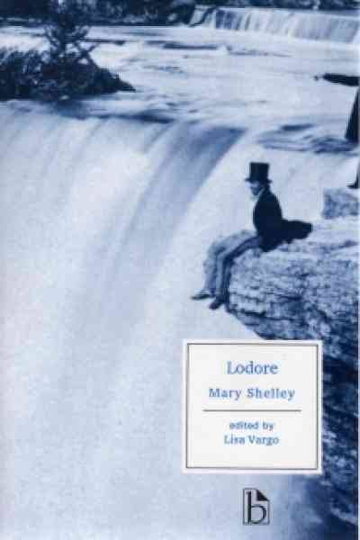
Mary Shelly’s books:
Frankenstein-1818
The Last Man -1826
Valperga – 1823
Mathilda- 1819
Lodore- 1835

Slide 9

Vocabulary
Poetka- poet
Pisarka- writer
Autorka- author
Zyskał- gained
Wielokrotnie- repeatedly
anonimowy- unnamed
Creates –stwarzać
romantic period- okres romantyku

Slide 10
Sources:
www.gwthomas.org
htomc.dns2go.com
www.vesper.pl
books.google.com
wasatchweatherweenies.blogspot.com
www.animatedimages.org
http://factmyth.com
wifflegif.com
www.signature-reads.com
inspirationalquotes.club
gochemless.com
picturetip.com
wifflegif.com
http://ulub.pl

Slide 11
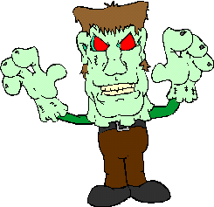
The end…
VIVIEN KOSEK
KL. 1 C

